Slide 1
Webinar
Gateway to knowledge:
Accessing data from established European social science research programmes
Sergeja Masten & Irena Vipavc Brvar Slovenian Social Science Data Archives
9 May 2025
Funded by the European Union

Slide 2
Welcome and housekeeping rules
This is a webinar-style session. Only panelists will be on video and audio. Attendees will remain muted till Q&A session.
Please use the Q&A panel to ask questions. We’ll address as many as possible during the Q&A segment. Avoid using the chat for questions to ensure we don’t miss anything.
Use the chat box for general comments or technical support only. Be respectful and courteous at all times.
This session is being recorded and will be shared with registrants afterward. By staying in the webinar, you consent to being part of the recording.
Technical Support: If you encounter issues, message the host/co-host via the chat.
Follow-Up:
A recording and any relevant resources will be emailed after the session and available via infra4next.com/.
After the session, please fill out short feedback form to help us improve.

Slide 3
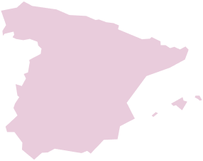
Map legend
22 Members
12 Partners
CESSDA
Is the Consortium of European Social Science Data Archives (Service Providers)
A true European research infrastructure.
Mission
To provide a sustainable research infrastructure that enables the research community to conduct high-quality
research in the social sciences
to contribute to effective solutions to the major challenges facing society today.

Slide 4
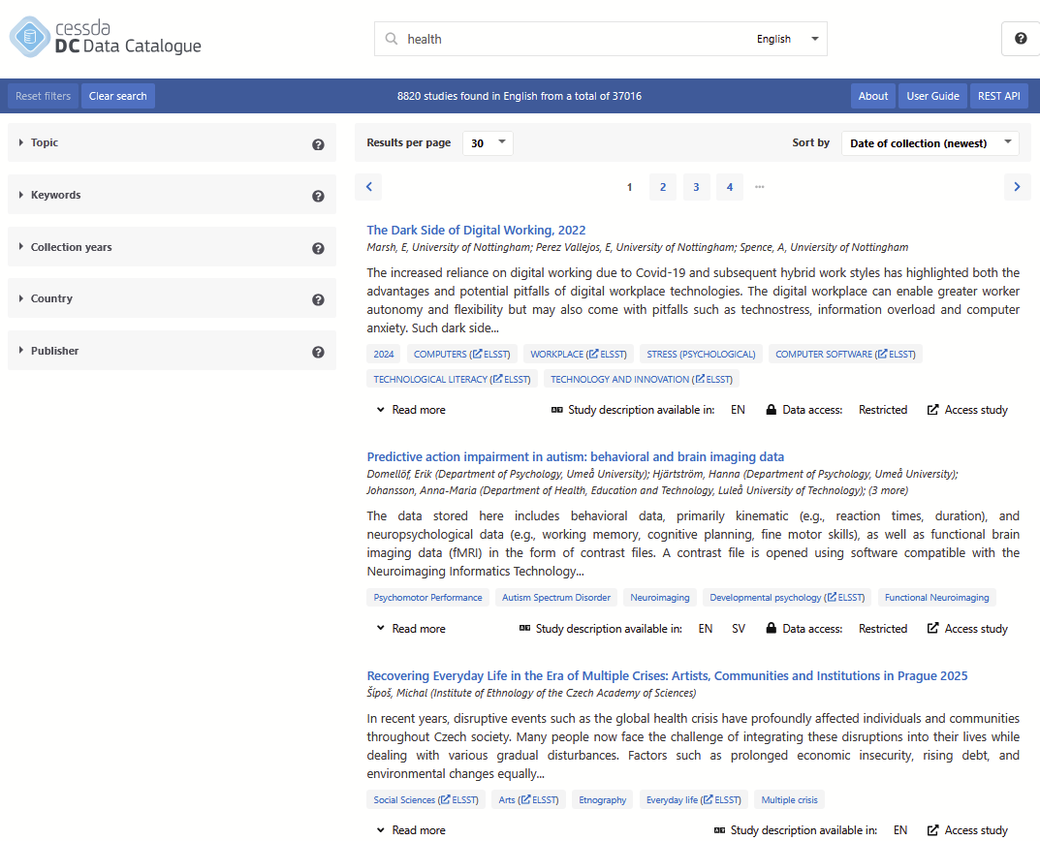
CESSDA Data Catalogue
Descriptions of research data created for social (and health) sciences – metadata on data
Provided by national social science data archives functioning as service providers for CESSDA ERIC
37,000+ datasets described, in various languages, most frequently in English.
Target users: researchers, research communities, students, businesses
Access to actual data through a link to the national repository web page of the data
REST API provided

Slide 5
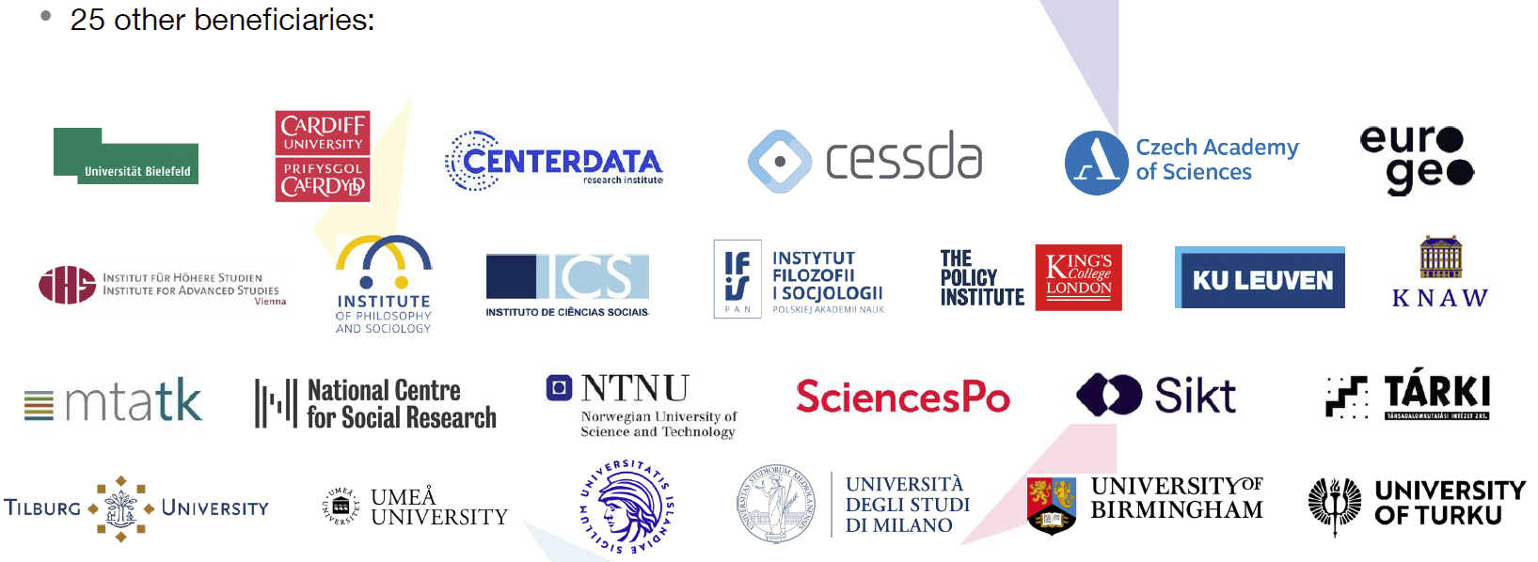
Infra4NextGen overview
€9.75m Horizon Europe project funded by European Commission
Coordinated by ESS ERIC with core RIs: CESSDA ERIC, EVS, and GGP
Aim to provide policy tailored outputs (data and data summaries)
Support five themes of the NextGenerationEU programme

Slide 6
Infra4NextGen: Aims
Consolidate, harmonise and summarise existing data and services according to the NextGenEU and youth policy topic areas
Ensure better visibility of existing RI data and services relevant to this EU priority and provide access to them
Engage key stakeholders in the development of this work whilst ensuring youth voices are clearly heard
Allow young Europeans to engage with the themes of future generation in a data-led environment
Better equip researchers and others to exploit existing and newly emerging data to help shape the future generation of society
Ensure the visibility of the results from Infra4NextGen amongst the residents and citizens of Europe

Slide 7
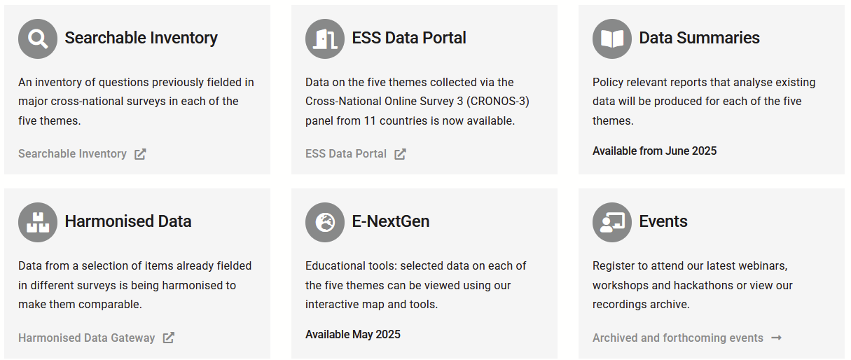
Infra4NextGen: Outputs
Based around EU youth policy and five key areas of NextGenEU recovery plan: Make it Green; Make it Digital; Make it Healthy; Make it Strong; and Make it Equal
Notes:
Extensive data summaries and inventories in five NextGenEU areas, tailored to the policy agenda
Harmonised datasets
New data collected through the CROss-National Online Survey 3 (CRONOS-3) Panel
Deliberative Forum findings through the Deliberative Mini Publics
E-Nextgen platform
Extensive training courses, materials and other actions

Slide 8
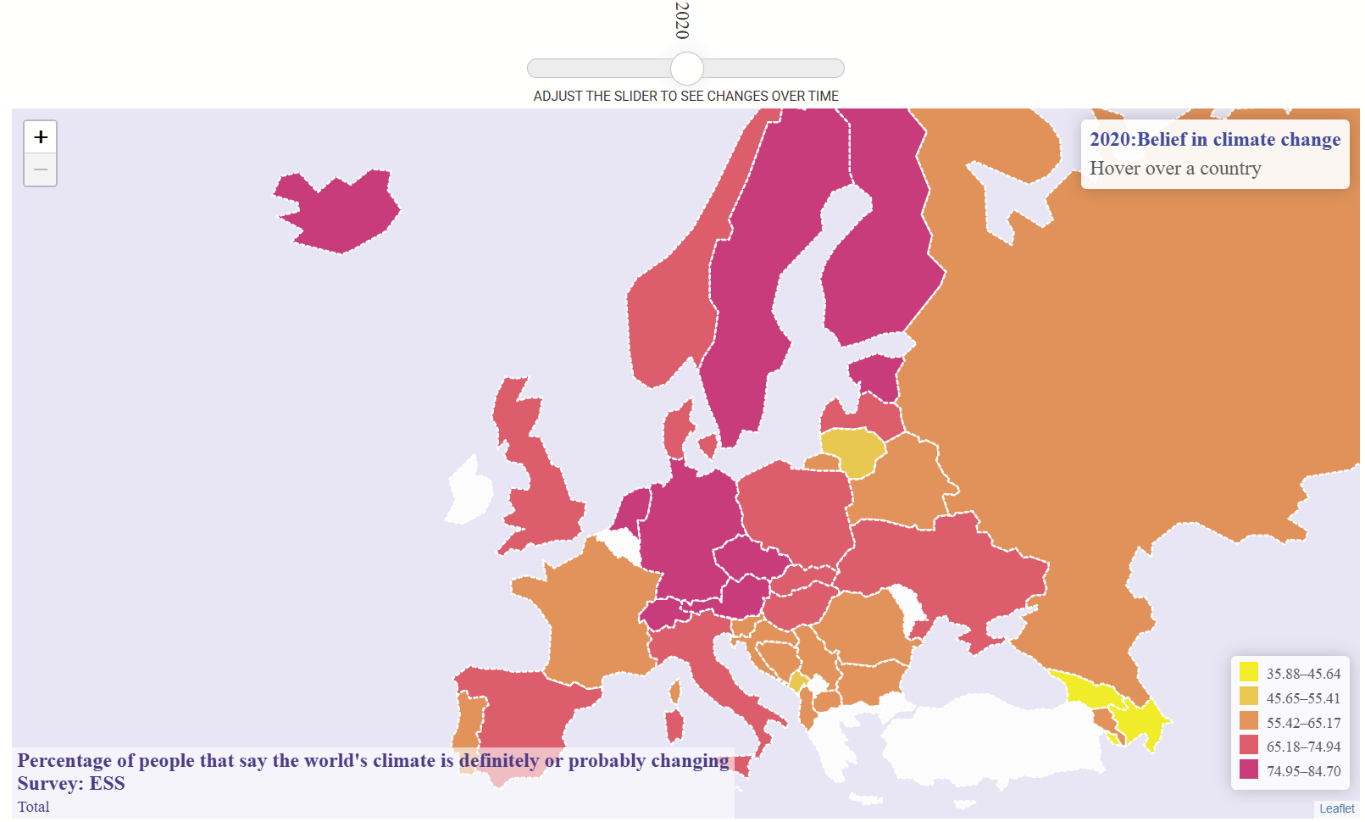
Sneak preview of the tool.

Slide 9
CROss-National Online Survey 3 (CRONOS-3) Panel
Part of Infra4NextGen project
Five waves of 90 questions (18 per wave for each NextGenEU area)
Questions developed by ESS and subject area experts
Recruitment from R10 and R11 main stage ESS interviews
Fielded in 11 countries (Austria, Belgium, Czechia, Finland, France, Hungary, Iceland, Poland, Portugal, Slovenia and the United Kingdom)
First wave in September 2024
Data will be analysed alongside existing data for a series of policy briefs

Slide 10
Webinar
Gateway to knowledge:
Accessing data from established European social science research programmes
Sergeja Masten & Irena Vipavc Brvar Slovenian Social Science Data Archives
9 May 2025
Funded by the European Union

Slide 11
Goals of this webinar
Understand data access to existing social science survey data in Europe.
Have clear guidance on the licensing terms and permissions required to reusing data and documentation.
Hold practical resources and guidelines to facilitate data access and reuse.
Have confidence in using established data and gain the necessary knowledge to effectively incorporate existing datasets into your research.
Be able to navigate research requirements – learn if a research ID is required and how to comply with data access policies.

Slide 12
European social science research programmes in focus
European Social Survey - ESS
CROss-National Online Survey - CRONOS
European Values Study - EVS
Gender and Generations Survey (GGS)

Slide 13
Established European SS Research Programmes: ESS & CRONOS
 | Purpose | Data collection method | Content | Frequency | Sample | Access
European Social Survey (ESS) | To measure changes in values, attitudes, and behaviors of people across Europe over time. | Face-to-face interviews (CAPI), standardized across participating countries | Core questions (e.g., trust, politics, migration) + rotating thematic modules. | Every 2 years since 2002 | Nationally representative samples (e.g., Slovenia), with several hundred to a few thousand respondents. | ESS data are available without restrictions, for not-for-profit purposes, pending only a very simple registration procedure.
CROss-National Online Survey panel (CRONOS) | To monitor social change between ESS rounds using online survey methods. | Online panel surveys – respondents were recruited from ESS participants | Shorter surveys focusing on timely topics (e.g., COVID-19, technology, politics) | 3 Rounds since 2016, with multiple waves | The same individuals surveyed multiple times (panel) in selected countries (e.g., UK, Slovenia, Estonia…). | Available via the ESS Data Archive, stored separately from main ESS datasets. Same conditions apply.
The EOSC Future Project | The EOSC Future Project aims to combine environmental data with data on people's attitudes and behaviors for social, political, and scientific analysis.

Slide 14
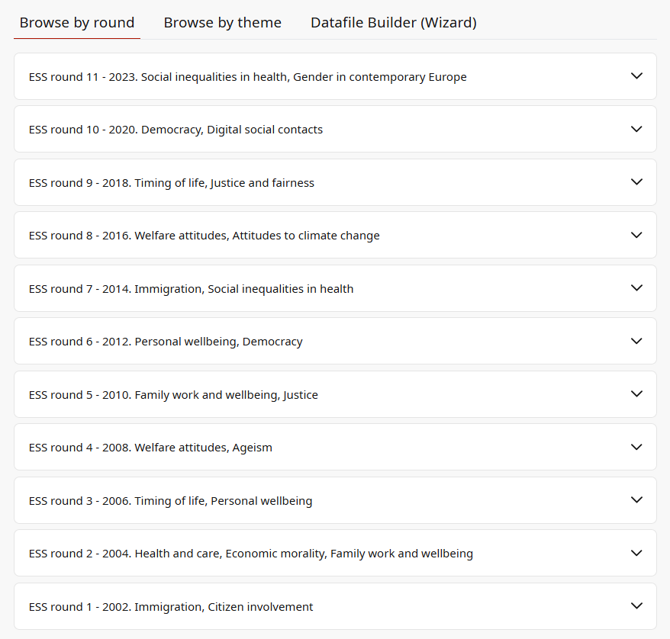
European Social Survey
(ESS) 2002-2023
The European Social Survey (ESS) has been conducted biennially since it started in 2002.
The survey measures the attitudes, beliefs and behaviour patterns of diverse populations in more than thirty nations. ESS includes a set of core questions asked in every round, as well as rotating modules that focus on current and thematically relevant issues (migration, gender, families, etc).
See all the Rounds on the ESS Data Portal: https://ess.sikt.no/en/

Slide 15
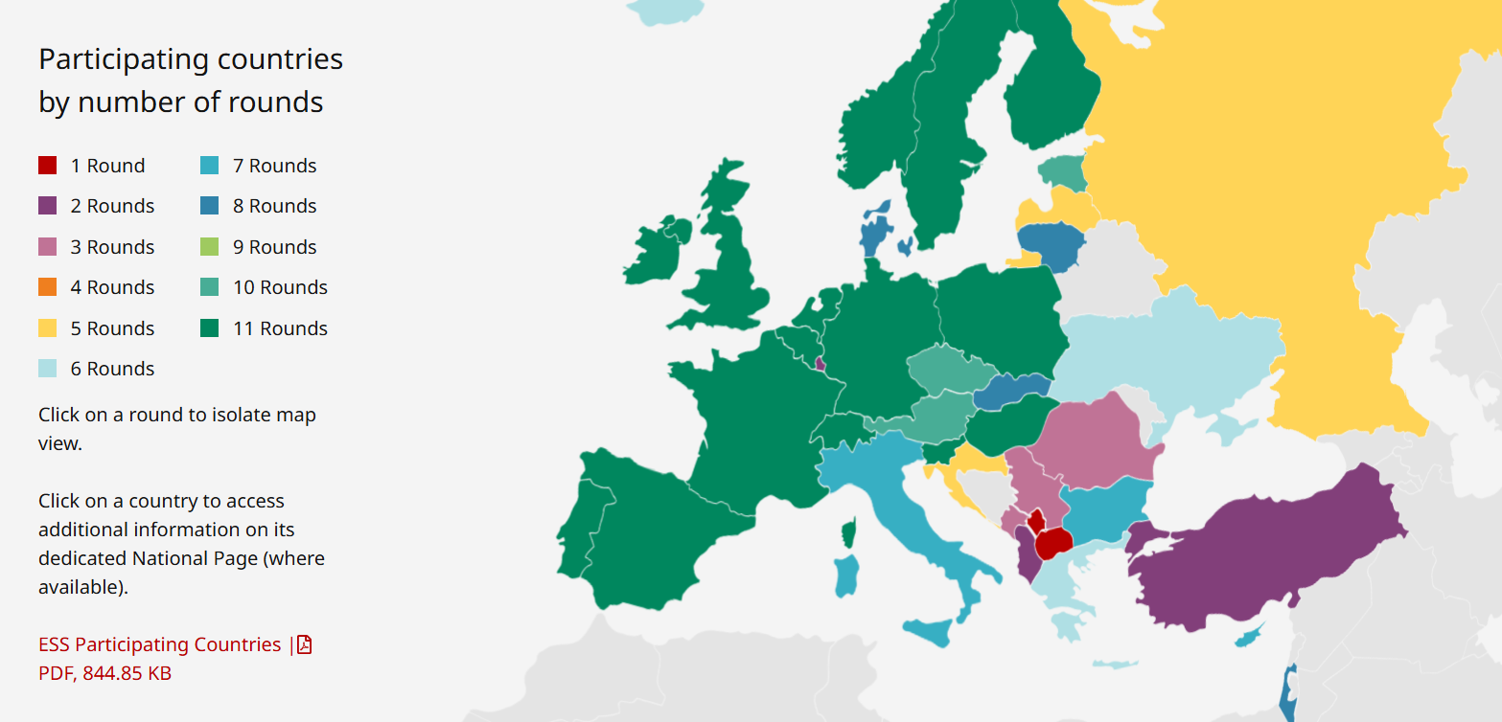
ESS participating countries by rounds (ESS11 - 31 countries)
https://www.europeansocialsurvey.org/about/participating-countries

Slide 16
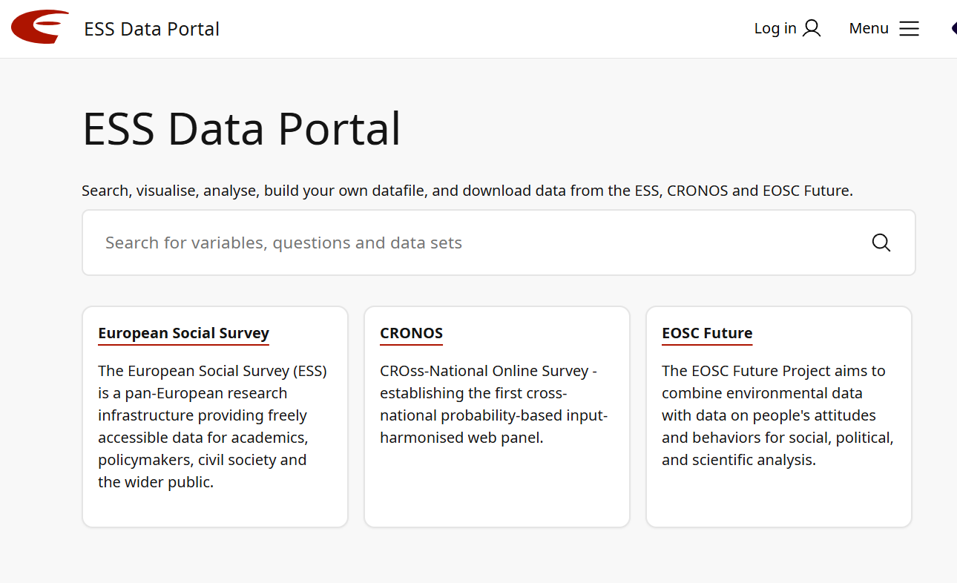
ESS datasets & documentation – ESS DATA PORTAL

Slide 17
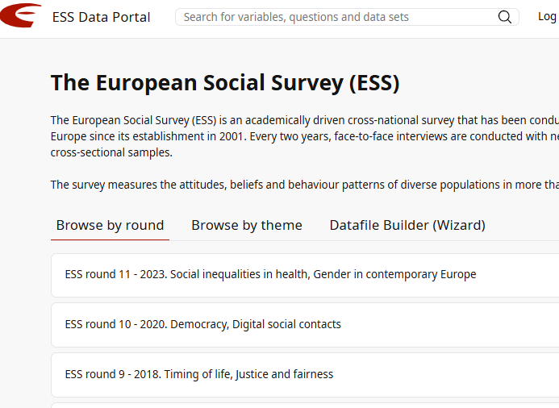
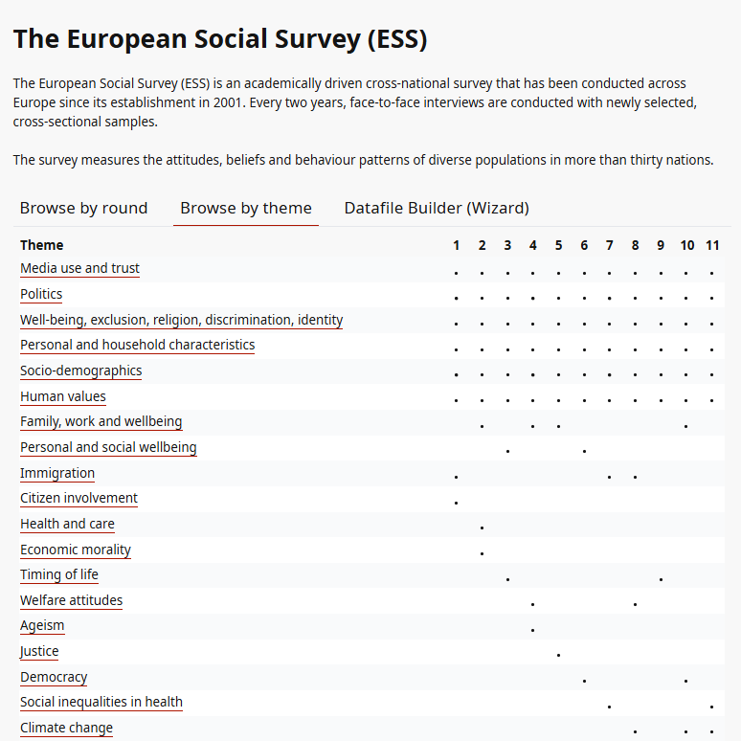
ESS datasets & documentation – ESS DATA PORTAL

Slide 18
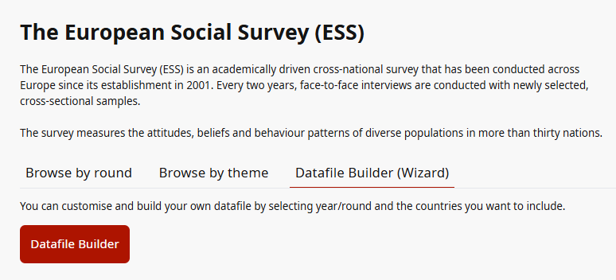
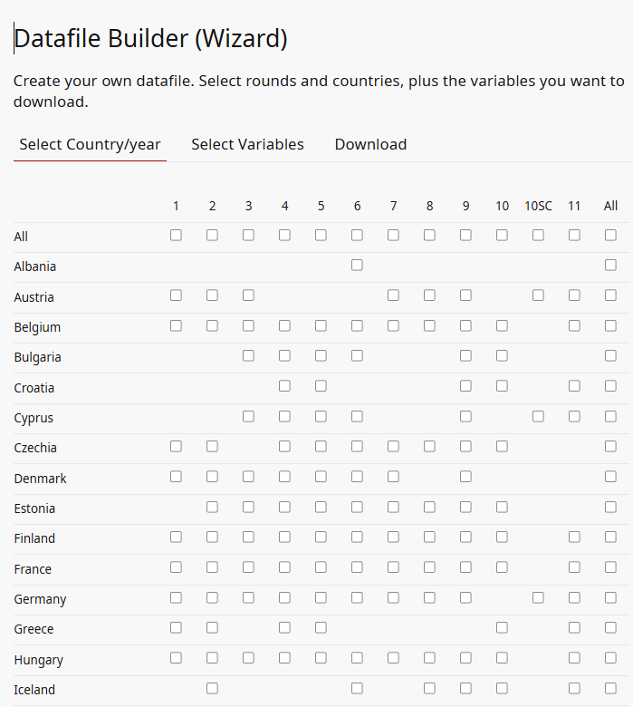
ESS datasets & documentation – ESS DATA PORTAL

Slide 19
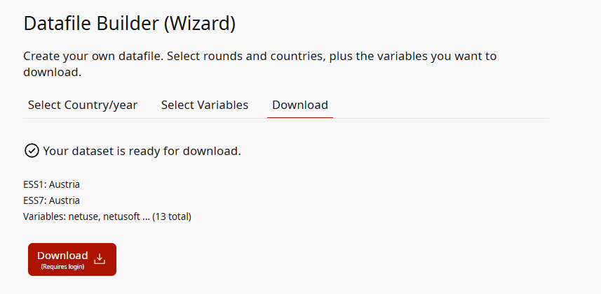
ESS Datafile Builder
Download upon registration!

Slide 20
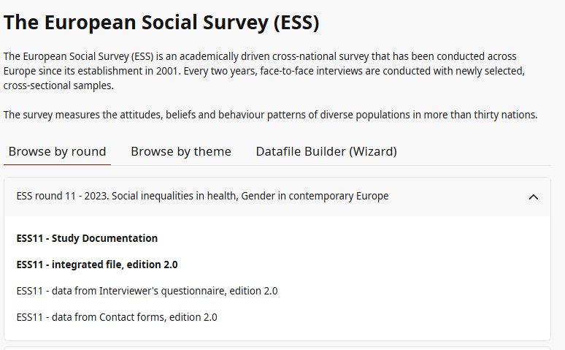
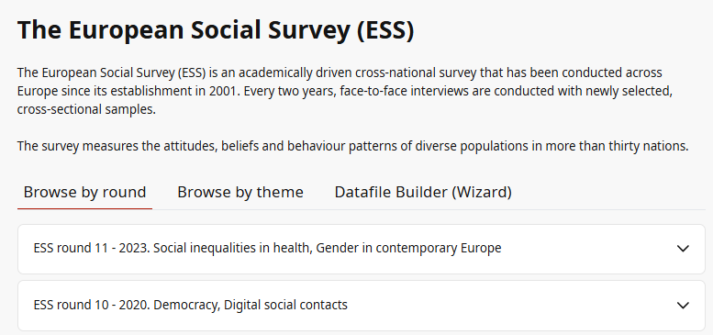
ESS datasets & documentation – ESS DATA PORTAL
Let’s go back to browse by round …
Data and documentation available for Round 11
https://ess.sikt.no/en/series/321b06ad-1b98-4b7d-93ad-ca8a24e8788a

Slide 21
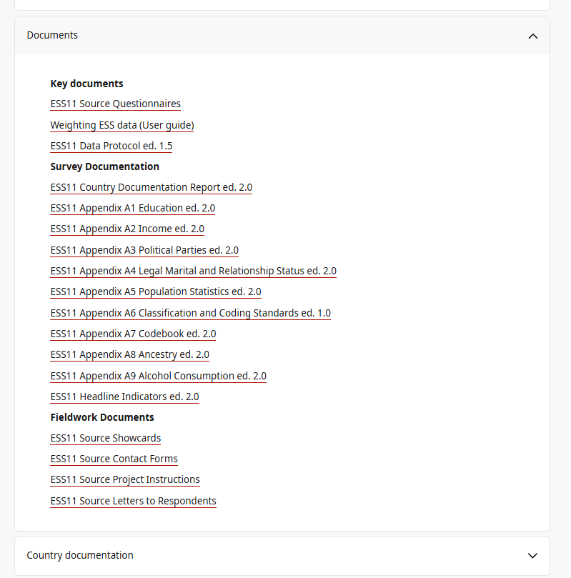
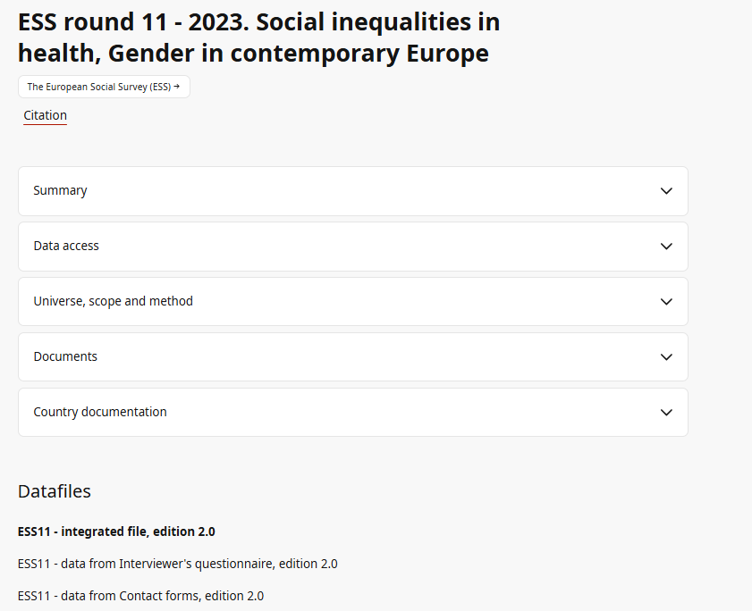
ESS 11 documentation
All documentation is available to download without register/login (.pdf format)

Slide 22
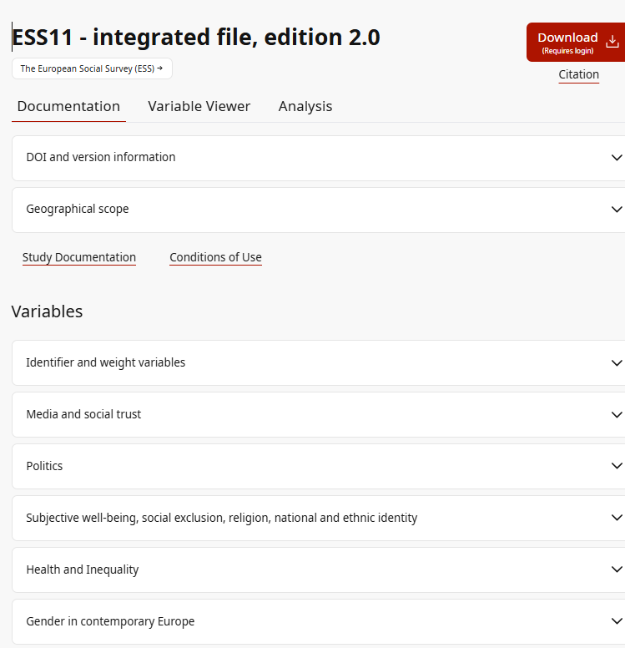
ESS 11 - Datafiles
All documentation is available to download without register/login (.pdf format)

Slide 23
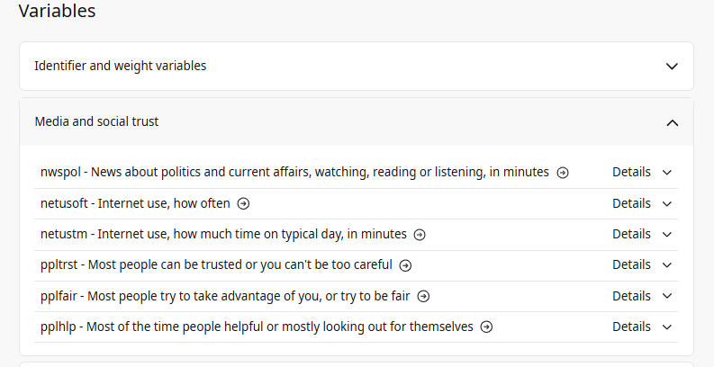
ESS 11 - Questions/Variables
Let’s see Media and Trust theme
All variables in this theme

Slide 24
ESS 11 - Questions/Variables
Let’s see Media and Trust theme - Variable ‘Internet use, how often’ in Variable viewer (click on small arrow)
All variables in this theme

Slide 25
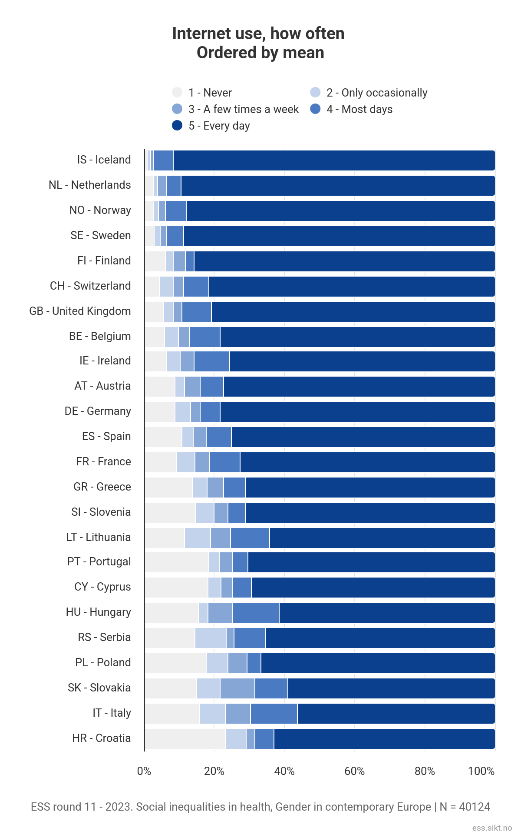
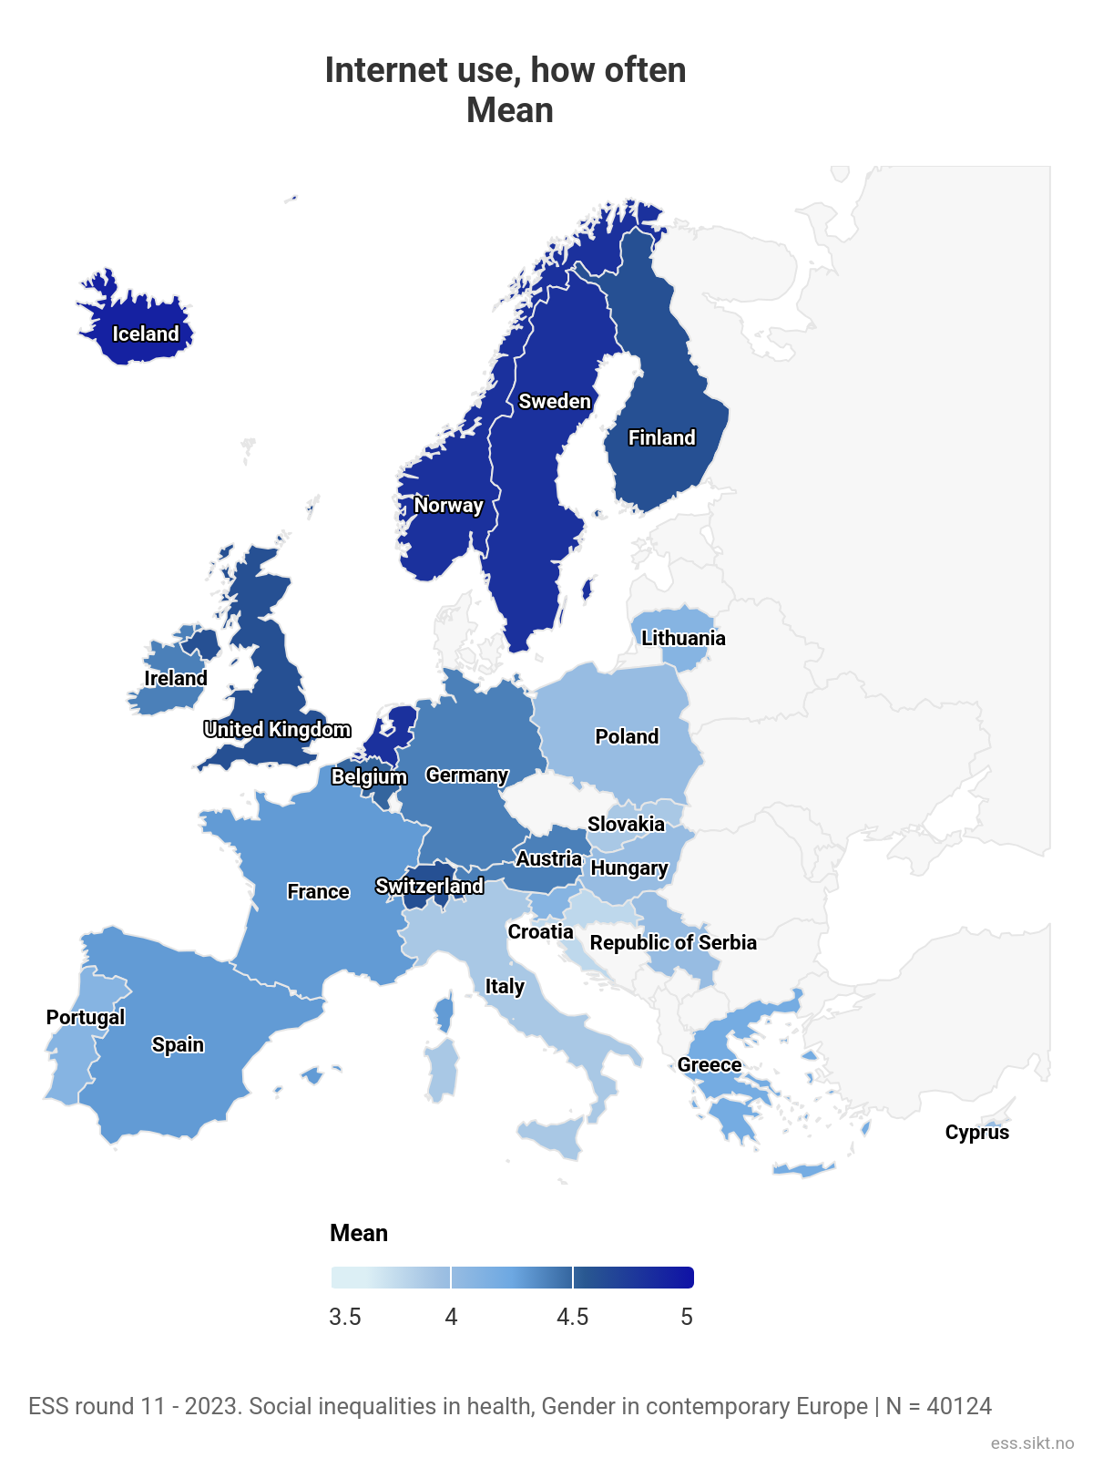
ESS 11 - Questions/Variables
Let’s see Media and Trust theme - Variable ‘Internet use, how often’ in Variable viewer
We get interactive graphs and a world map for comparison.

Slide 26
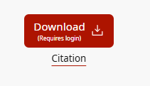
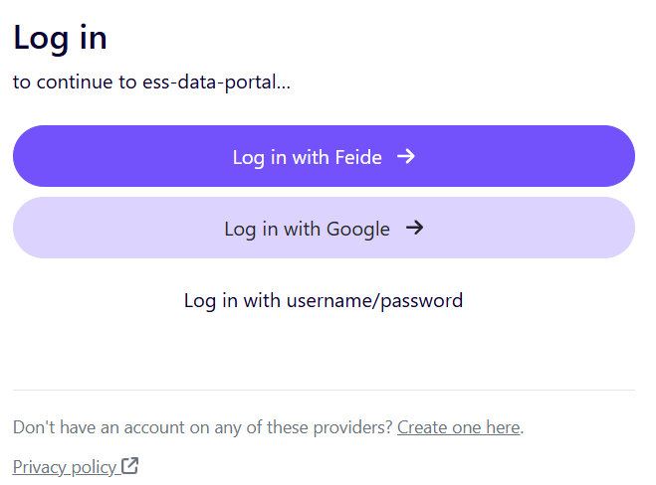
REGISTRATION/LOGIN to GET ESS DATA IS REQUIRED

Slide 27
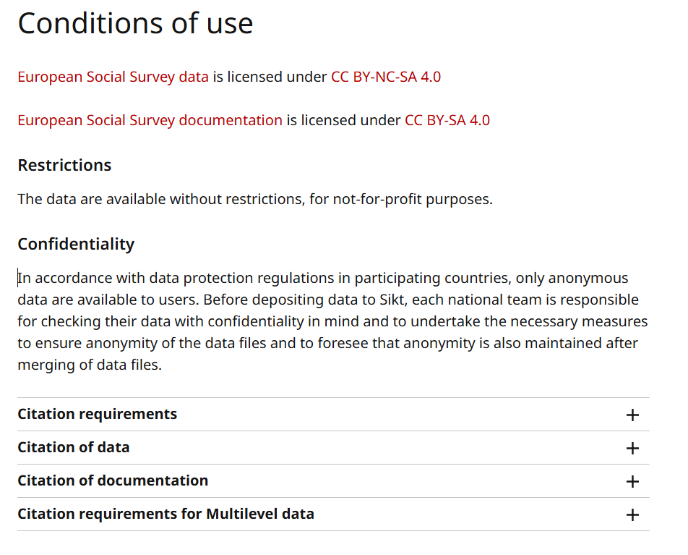
ESS Data & Documentation ACCESS & LICENCES
https://www.europeansocialsurvey.org/contact/disclaimer
European Social Survey data is licensed under CC BY-NC-SA 4.0
European Social Survey documentation is licensed under CC BY-SA 4.0

Slide 28
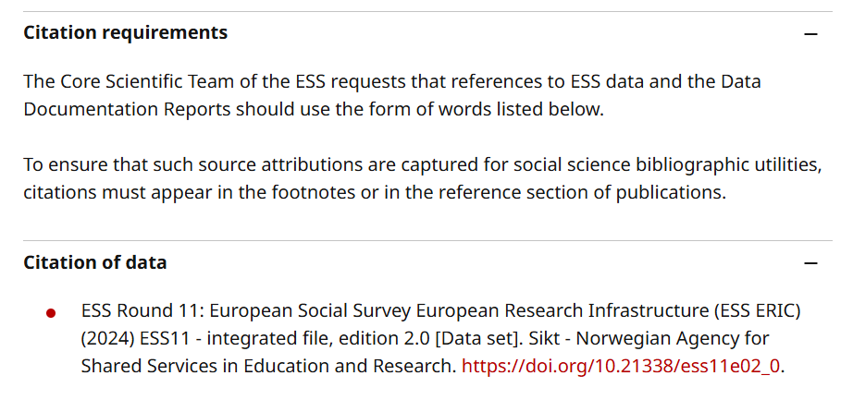
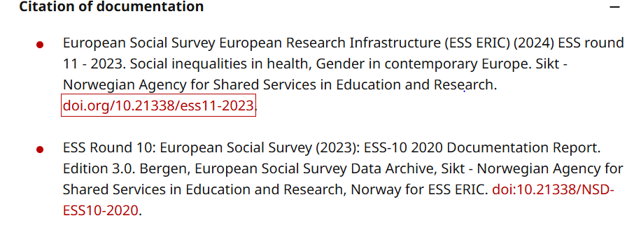
ESS Data & Documentation CITATION
https://www.europeansocialsurvey.org/contact/disclaimer

Slide 29
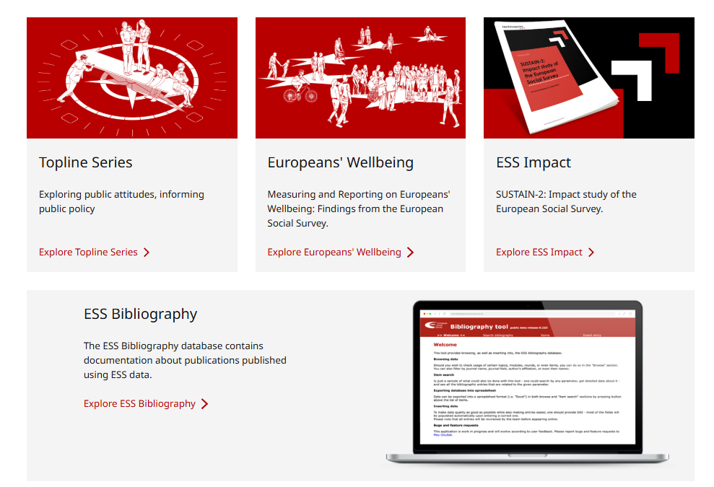
More resources about ESS
https://www.europeansocialsurvey.org/findings

Slide 30
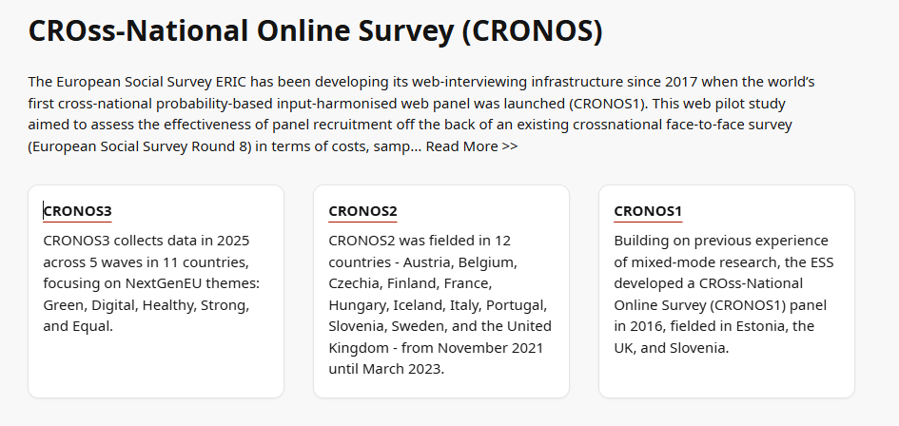
CROss-National Online Survey (CRONOS) - part of ESS
The European Social Survey ERIC has been developing its web-interviewing infrastructure since 2017 when the world’s first cross-national probability-based input-harmonised web panel was launched (CRONOS1).
This web pilot study aimed to assess the effectiveness of panel recruitment off the back of an existing crossnational face-to-face survey (European Social Survey Round 8)
CRONOS 1 served as a ‘proof of concept’ to prove the feasibility of a web panel.
https://ess.sikt.no/en/series/655615e6-8e4f-4e84-a9c9-27d24b93f866

Slide 31
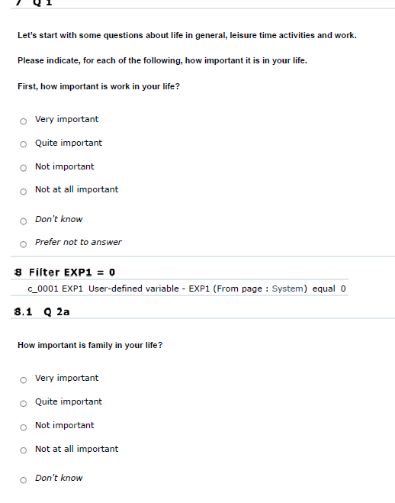
CROss-National Online Survey (CRONOS)
Questions - different as in ESS but some topics overlaps (political trust, media use, attitudes towards EU etc.)
CRONOS = designed for quick data collection on methodologically sound sample.

Slide 32
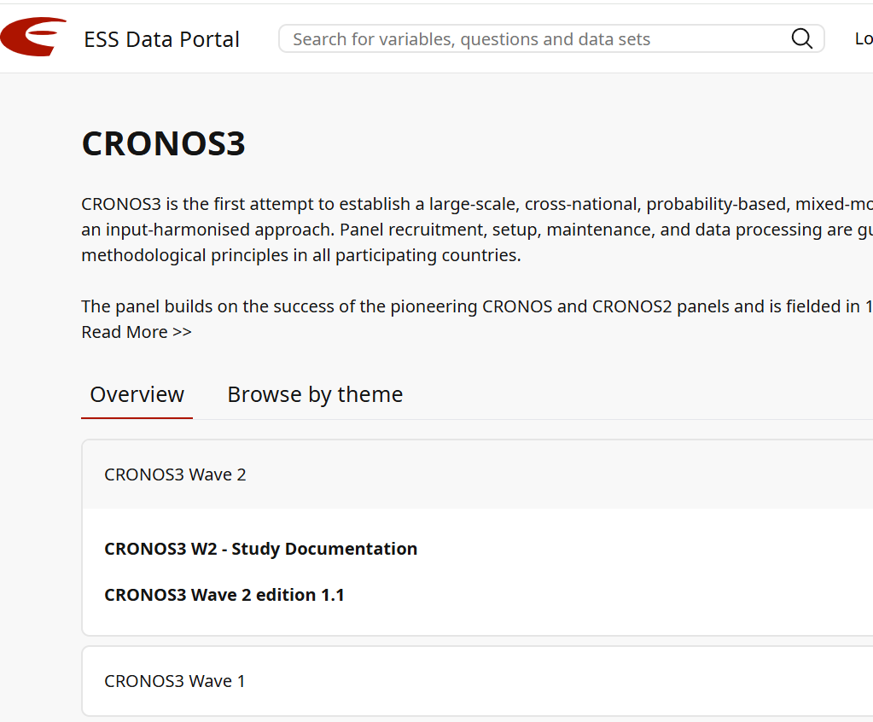
CROss-National
Online Survey
(CRONOS)
All
documentation
is available
without registrations.
https://ess.sikt.no/en/series/a46bcac5-b030-444b-9280-441ec97e1bce?tab=overview

Slide 33
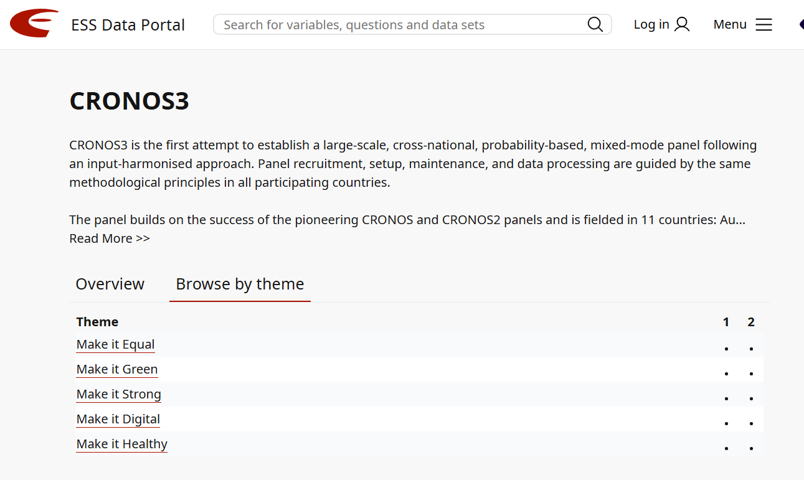
CROss-National
Online Survey
(CRONOS)
You can browse by
topics.
https://ess.sikt.no/en/series/a46bcac5-b030-444b-9280-441ec97e1bce?tab=themes

Slide 34
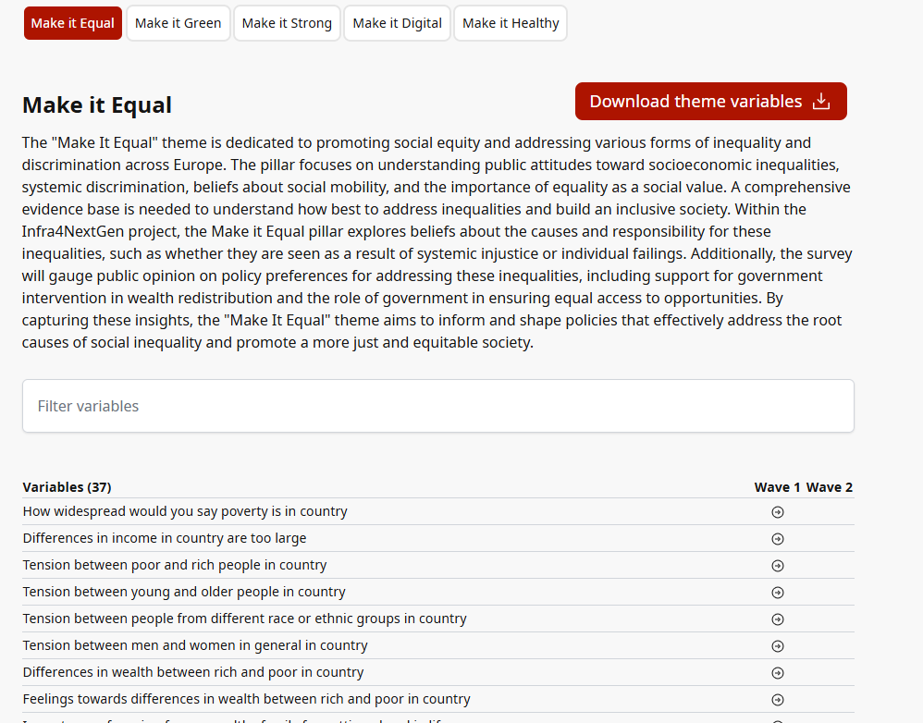
CROss-National
Online Survey
(CRONOS)
Theme ‘Make it Equal’
from CRONOS3
https://ess.sikt.no/en/theme/a46bcac5-b030-444b-9280-441ec97e1bce/218bcfdb-2c1b-4b2b-b96a-932ed286fb96
arrows lead directly to Variable Viewer

Slide 35
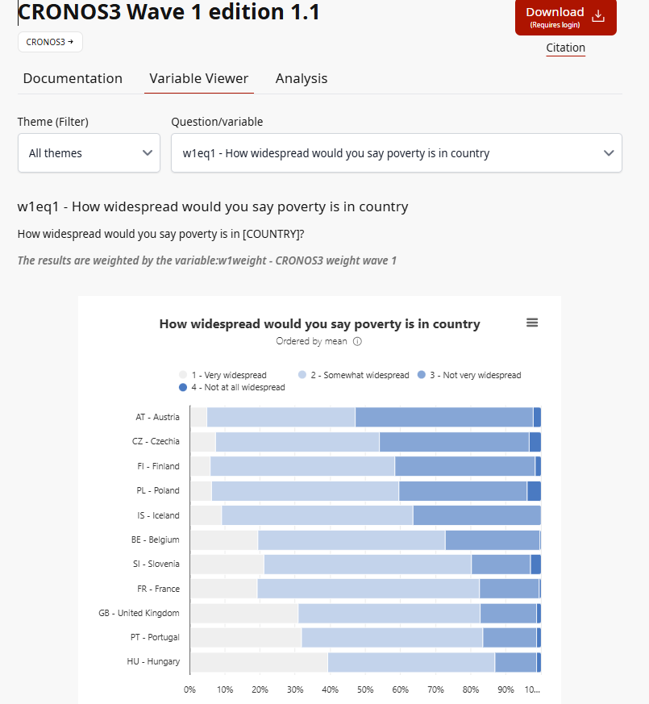
CROss-National
Online Survey
(CRONOS)
w1eq1 - How widespread would you say poverty is in country
How widespread would you say poverty is in [COUNTRY]?
https://ess.sikt.no/en/datafile/8e311a9b-6539-4e40-8c7f-aeb0e7b82ab1/60?tab=1&elems=854e5f95-9649-41ad-84ea-3b0b2a78fac6_2

Slide 36
CROss-National Online Survey (CRONOS)
Data & Documentation Access and conditions
CRONOS is based on ESS sample and the same rules for using and sharing data and documentation apply to CRONOS
https://www.europeansocialsurvey.org/contact/disclaimer

Slide 37
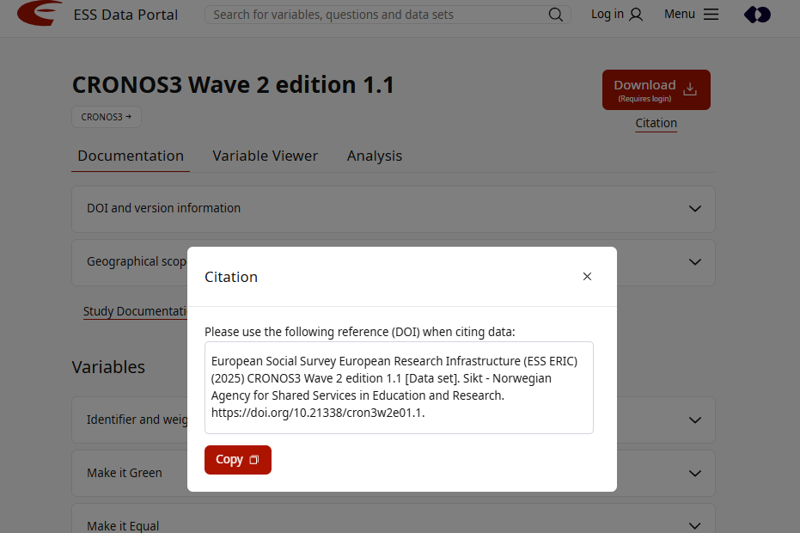
CRONOS DATA & DOCUMENTATION CITATION
‘Citation’ option on a different place when click on ‘Documentatio’

Slide 38
European Values Survey (EVS)

Slide 39
European VAlues Study (EVS) Overview
 | Purpose | Collection method | Content | Frequency | Sample | Access
European Values Study (EVS) | To explore long-term changes in fundamental human values across Europe, such as religion, family, work, politics, and society. | Face-to-face interviews, using standardized questionnaires across countries; in later waves also online or mixed modes | Focused on value systems – religion, identity, trust, work, well-being, democracy | Approximately every 9 years since 1981 (waves in 1981, 1990, 1999, 2008, and 2017–2022) | Nationally representative samples. | Access to the data from the European Values Study (EVS) is free of charge but requires registration with GESIS – Leibniz Institute for the Social Sciences.

Slide 40
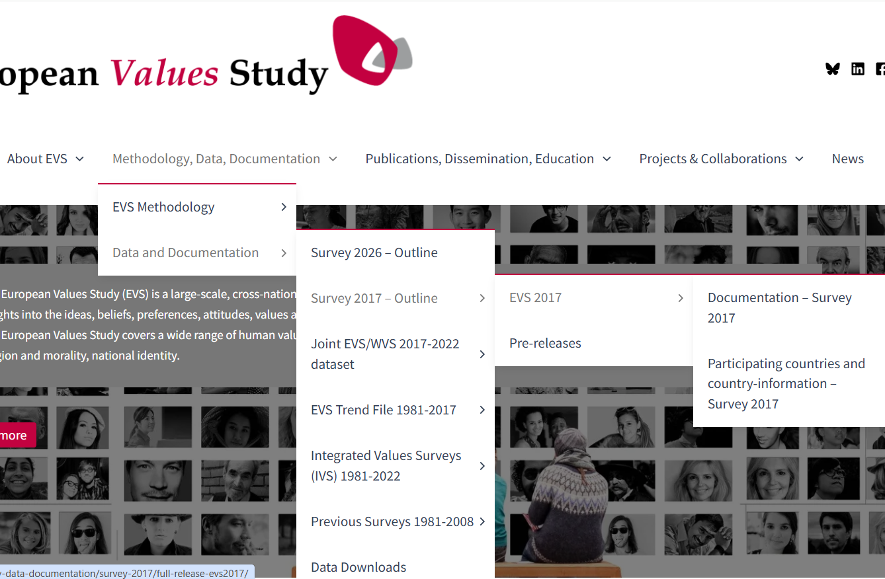
European
Values
Study (EVS) Overview
All documentation available on website.
Datasets can be downloaded on GESIS Data Search portal.

Slide 41
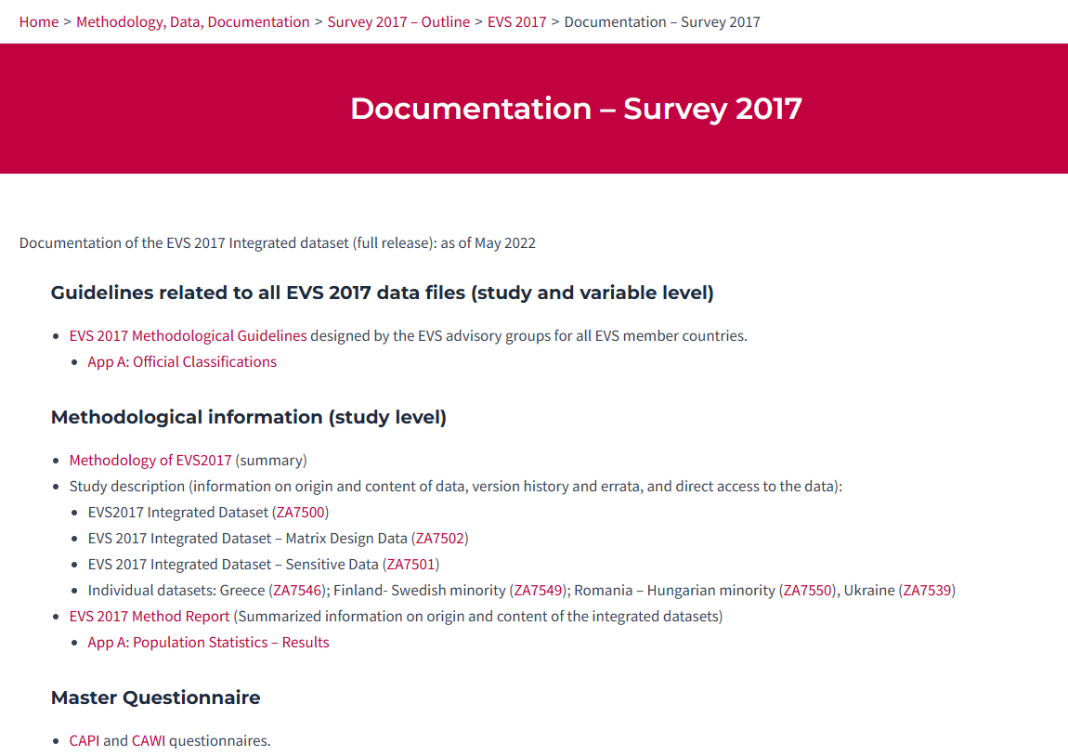
European
Values
Study (EVS) Overview
All documentation available on website + GESIS.
Datasets can be downloaded on GESIS Data Search portal.
https://europeanvaluesstudy.eu/methodology-data-documentation/survey-2017/full-release-evs2017/documentation-survey-2017/

Slide 42
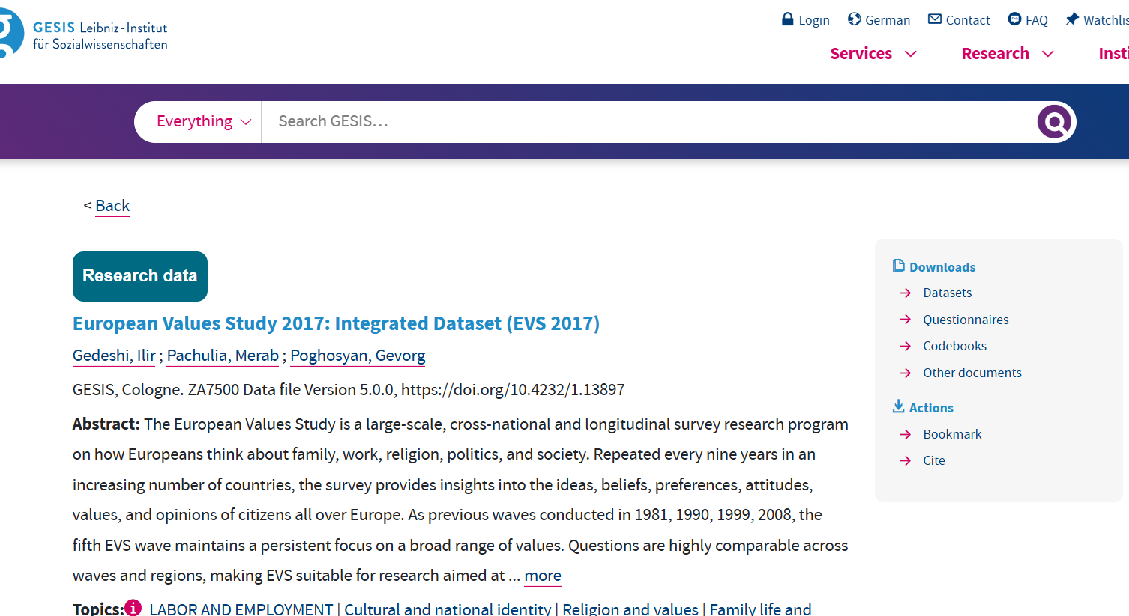
European Values Study (EVS) DATA on GESIS SEARCH

Slide 43
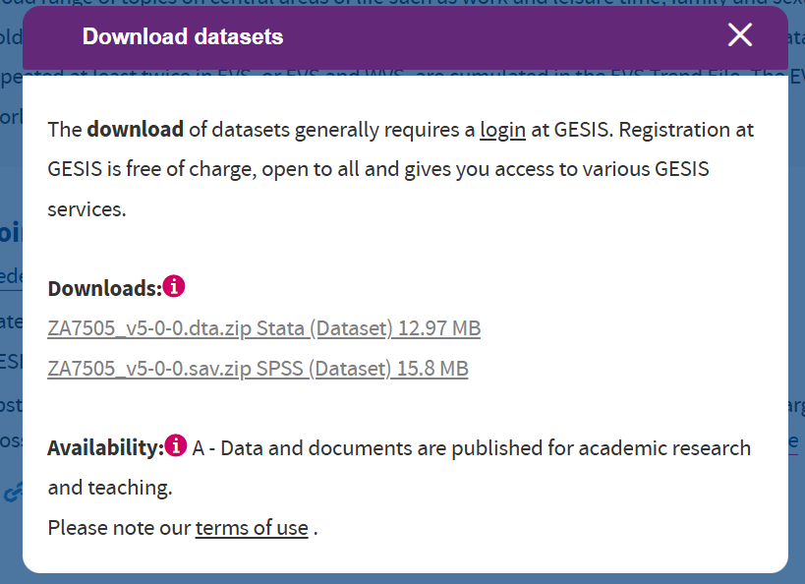
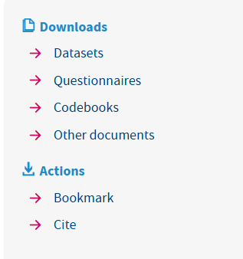
EVS
DATA ACCESS
on GESIS SEARCH
Check for
every dataset
https://www.gesis.org/en/institute/data-usage-terms

Slide 44
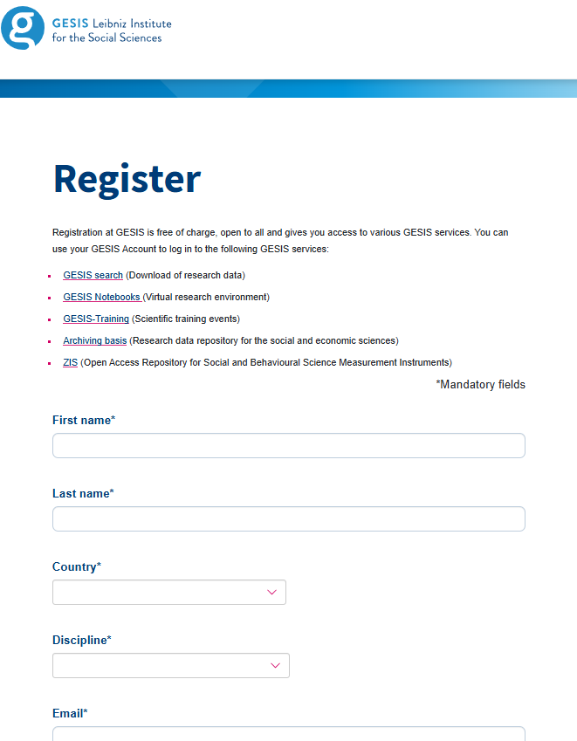
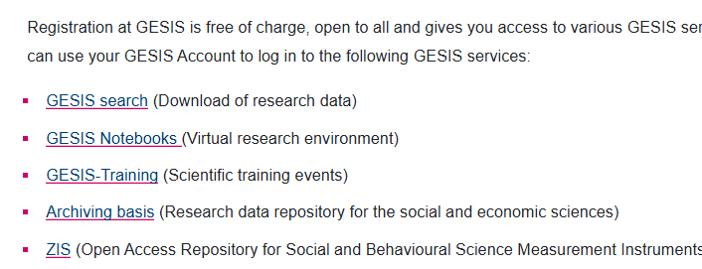
EVS DATA ACCESS on
GESIS SEARCH
- Login/registration
https://login.gesis.org/realms/gesis/login-actions/registration?client_id=gesis-gws-client&tab_id=RnsDceVVudY&client_data=eyJydSI6Imh0dHBzOi8vc2VhcmNoLmdlc2lzLm9yZy9yZXNlYXJjaF9kYXRhL1pBNzUwMj9sYW5nPWVuIiwicnQiOiJjb2RlIiwicm0iOiJmcmFnbWVudCIsInN0IjoiNTQ1NjJmYTYtNGI0Ni00NGQ3LThmZTYtYzM4ZGVlNjdkNTg1In0

Slide 45
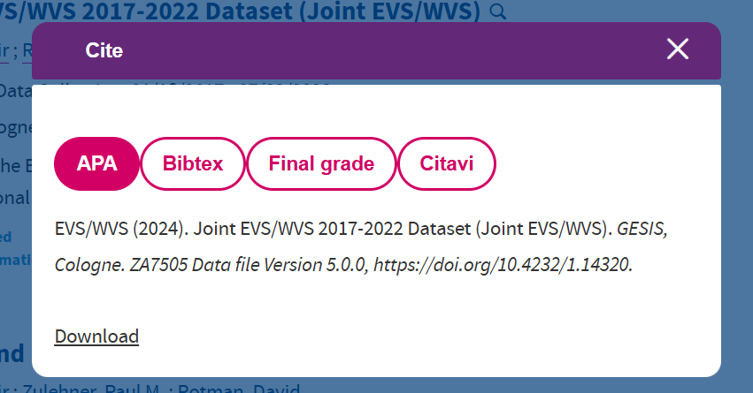
EVS DATA CITATION
GESIS provides pre-formatted citation options for each dataset.

Slide 46
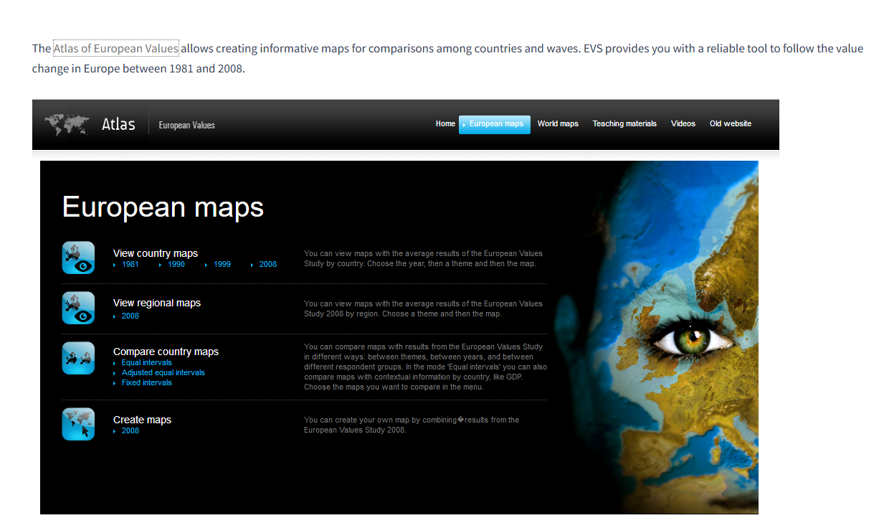
European
Values
Study (EVS)
World map - value change
https://europeanvaluesstudy.eu/methodology-data-documentation/maps/

Slide 47
About GGS
The Gender and Generations Survey (GGS) is a large-scale, longitudinal study conducted across multiple countries, focusing on relationships, family dynamics, and demographic behavior.
It collects data on fertility, partnership, parenting, ageing, and intergenerational exchanges, with a special focus on gender roles and how they evolve across generations.
The GGS is part of the Generations and Gender Programme (GGP), coordinated by a consortium of international research institutions, and aims to inform social policy and understand population change in developed countries.
Started in 2000 by UNECE Both genders in the sample, age 18-79
Coordinated by NIDI since 2009 Longitudinal (3 Y interval);
More than 20 countries (beyond EU)
Notes:
has been coordinated by the Netherlands Interdisciplinary Demographic Institute since 2009.
Respondents are interviewed every 3 years and changes in the family life are recorded. Importantly, the GGP covers the whole adult life-course, between the age of 18 and 79, and is therefore the only dataset dedicated to the longitudinal and cross- national study of family life and generational relationships from early adulthood to older ages. Over time, the GGP follows respondents through relationships, marriages, parenthood, divorces, deaths and many of the trials and tribulations that people meet with, tracking the impact and consequences of these
events at an individual and societal level.

Slide 48
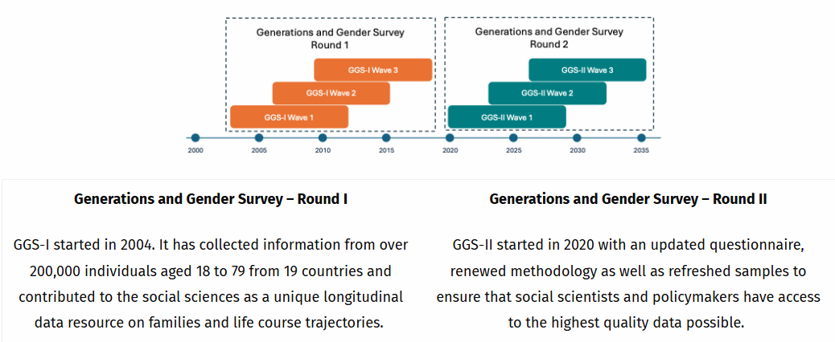
Source
Notes:
GGS applies a panel design – collecting information on the same persons at three-year intervals – to allow the examination of causes and consequences of inequalities between genders and generations.

Slide 49
Source
Notes:
Britain - Exit, Climate change, COVID

Slide 50
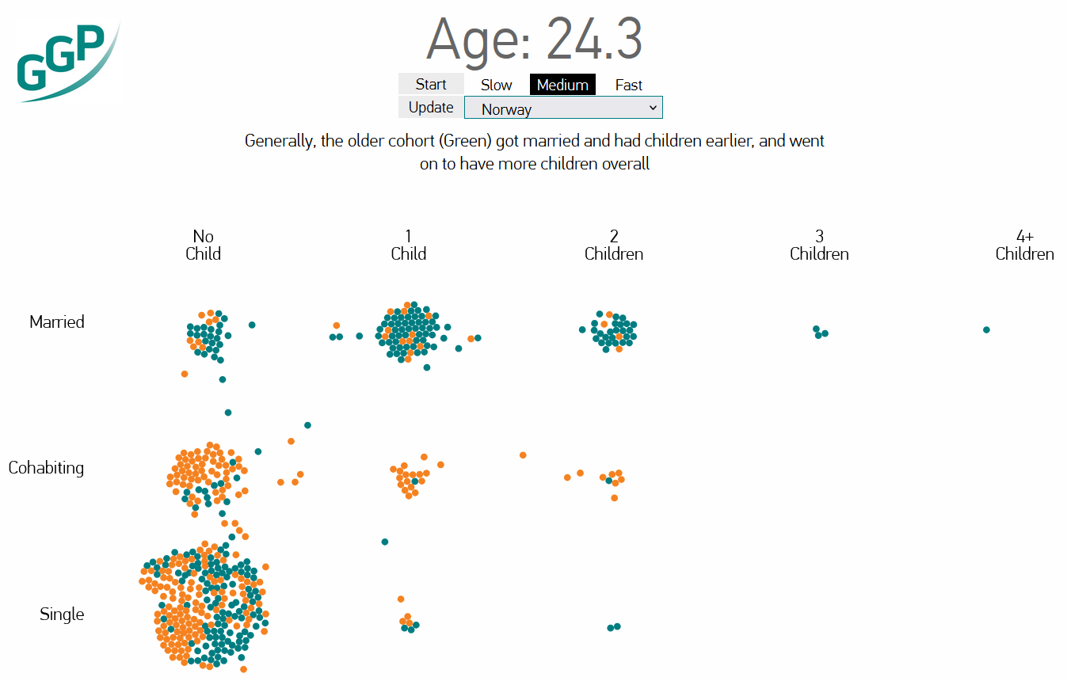
RUN THE ANIMATION!! Source
“At the Age of 15 pretty much everybody is single and doesn’t have any children so they start down in the bottom left hand corner. Then as time passes some find a partner to live with and some even get married. When they do, the little dot that represents them moves up to represent this change in their relationship status. As time passes some people also have children, and to represent this the dot moves to the right for every additional child they have.”
Born in 1950
Born in 1970
Notes:
At the Age of 15 pretty much everybody is single and doesn’t have any children so they start down in the bottom left hand corner. Then as time passes some find a partner to live with and some even get married. When they do, the little dot that represents them moves up to represent this change in their relationship status. As time passes some people also have children, and to represent this the dot moves to the right for every additional child they have.
The dots in the visualization are two different colours to represent two groups of people. The green dots are people who were born in 1950. They would have been 17 during the ‘summer of love’ and 35 years old during the ‘Live Aid’ concert in 1985. They are commonly called ‘baby boomers’. The orange dots are people who were born in 1970. They were 19 when the Berlin Wall fell and 30 at the turn of the Millennium. They are generally referred to as ‘Generation X’. These two generations have lived quite different lives, as the visualization shows.

Slide 51
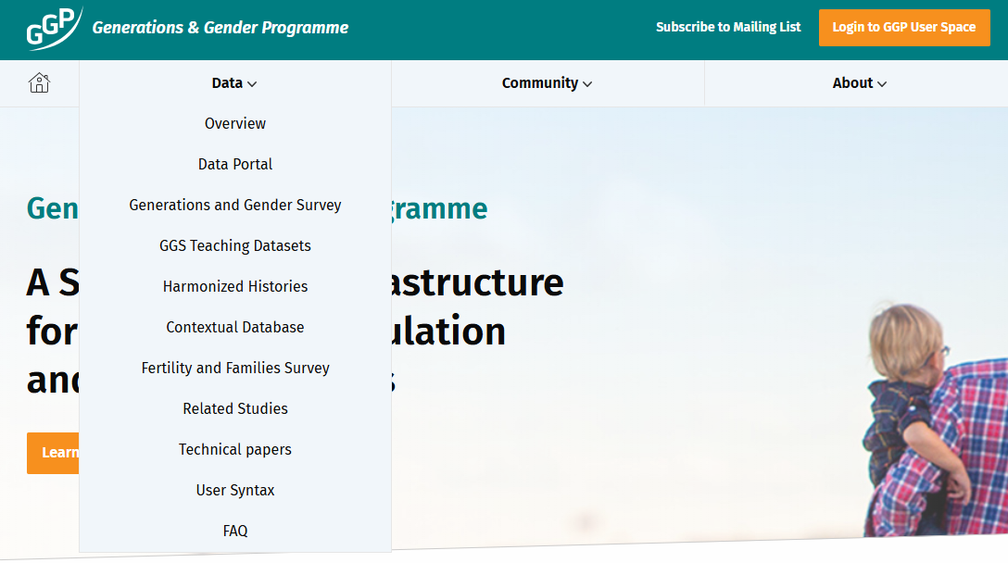

Slide 52
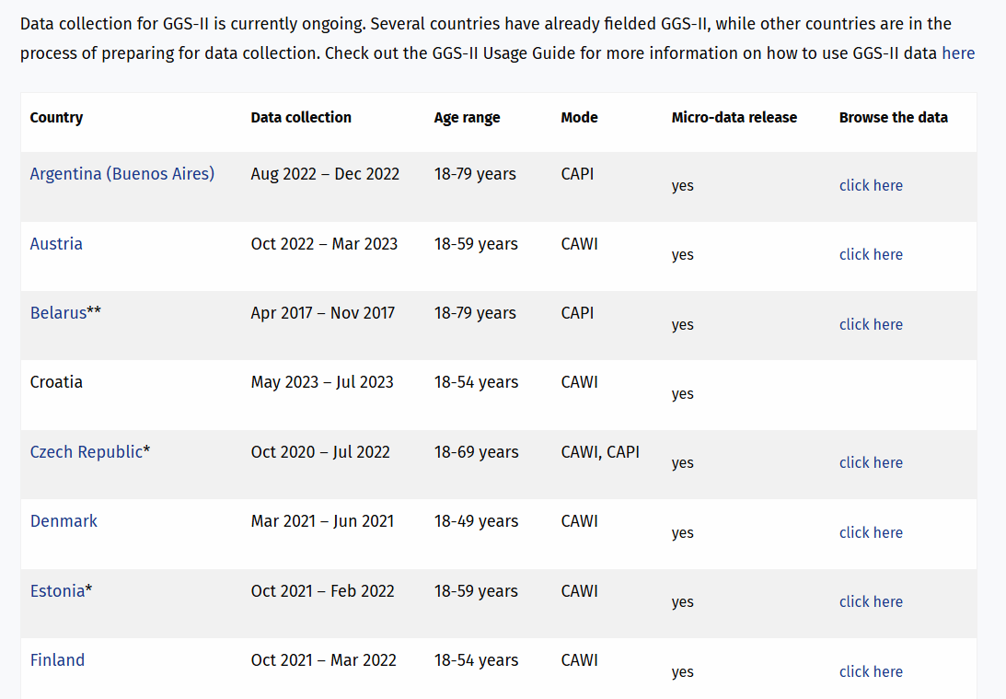
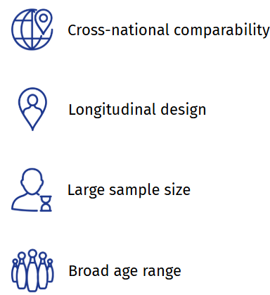
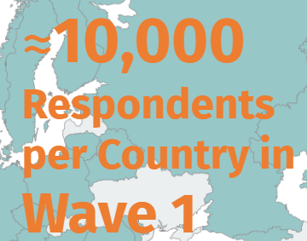
Source

Slide 53
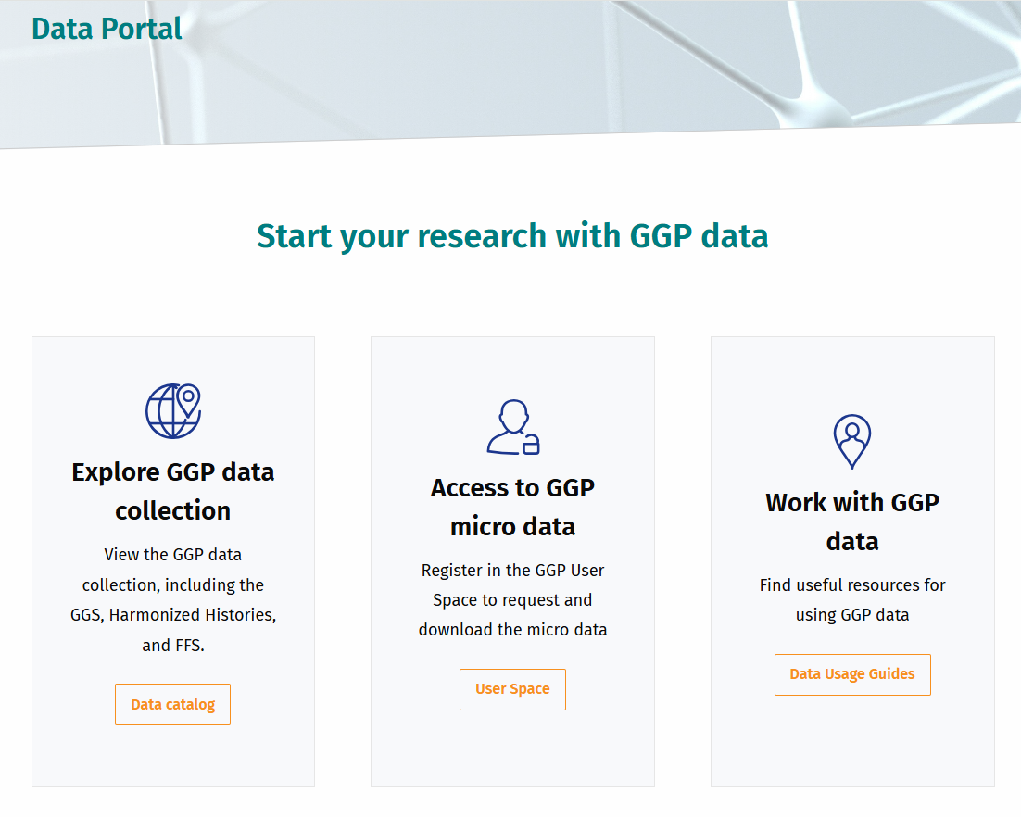
Gauthier, A., Liefbroer, A., Ajzen, I., Aassve, A., Beets, G., Billari, F., Bühler, C., Bujard, M., Cabaço, S., Corijn, M., Désesquelles, A., Dommermuth, L., Dykstra, P., Emery, T., Fadel, L., Fokkema, T., Hansen, T., Hlebec, V., Hoem, J., … Vikat, A. (2022). Generations and Gender Survey: Baseline Questionnaire (3.1.1). Netherlands Interdisciplinary Demographic Institute. https://doi.org/10.5281/zenodo.12724457

Slide 57
Source

Slide 58
Source

Slide 61
https://www.ggp-i.org/form/accounts/register/

Slide 65
“For whom is (1) university education; (2) having a job, (3) looking after the home/children more important?”
Respondent aged 18-35.

Slide 66
Q&A

Slide 67
Lessons Learned: Accessing Social Science Survey Data in Europe
✅ Understand Data Access Pathways Gain clarity on how to access existing survey data, including registration, approval, and download processes.
✅ Clarify Licensing Terms Know the specific licensing conditions and permissions for reusing data and accompanying documentation.
✅ Use Practical Guidance & Resources Leverage existing tools, guides, and best practices to streamline data access and reuse.
✅ Build Confidence in Using Existing Data Strengthen your ability to evaluate and integrate high-quality, established datasets into your research.
✅ Navigate Research Requirements Learn whether a research ID is required and how to comply with institutional or dataset-specific access policies.

Slide 68
https://infra4nextgen.com/i4ng-events/forthcoming-events/

Slide 69
Contact
sergeja.masten@fdv.uni-lj.si; irena.vipavc@fdv.uni-lj.si
Infra4nextgen.com
Arhiv.Druzboslovnih.Podatkov

